Slide 1
Parameter Passing

Slide 2
Primitive Parameters
Primitive types: boolean, byte, char, short, int, long, float, double
In Java, all primitives are passed by value. This means a copy of the value is passed into the method
Modifying the primitive parameter in the method does NOT change its value outside the method

Slide 3
Object Parameters
Objects can be passed natively, just like primitives

Slide 4
Complex {
Private double real;
Private double imag;
Public Complex() // Default Constructor
{ real = 0.0; imag = 0.0; }
Public Complex( Complex c) // Default Constructor
{this. real = ; imag = 0.0; }
Public Complex (double r, double im)
{ real = r; imag = im; }
Public Complex Add (Complex b)
{
Double r= this.real + b.real;
Double i = imag + b.imag;
Complex c_new = new Complex (r,i);
return c_new;
}
Public Show ()
{
System.out,println( real + imag);
}
Public class ComplexTest {
void main()
{
Complex C1 = new Complex(11, 2.3);
Complex C2 = new Complex(9, 2.3);
Complex C3 = C1.Add(C2);
C3.show();
Complex c4 = c2;
}
}

Slide 5
Objects are passed by Value
It is often misstated that Object parameters are passed by Reference.
While it is true that the parameter is a reference to an Object, the reference itself is passed by Value.

Slide 6
Modify a Parameter Value
…
Point p = new Point(10, 20);
addTen(p);
System.out.println(p.x + “,“ + p.y);
…
void addTen(Point pa) {
pa.x = pa.x + 10;
pa.y = pa.y + 10;
}

Slide 7
Modify a Parameter Value
The output of the System.out.println will be 20, 30

Slide 8
public class ObjectPass {
public int value;
public void increment(ObjectPass a){
a.value++;
}
}
Public class ObjectPassTest {
public static void main(String[] args) {
ObjectPass p = new ObjectPass();
p.value = 5;
System.out.println("Before calling: " + p.value);
p.increment(p);
System.out.println("After calling: " + p.value);
}
}

Slide 9
Output
Before calling: 5 After calling: 6

Slide 10
The point here is that what we pass exactly is a handle of an object, and in the called method a new handle created and pointed to the same object.
Now when more than one handles tied to the same object, it is known as aliasing.

Slide 11
From the example above you can see that both p and a refer to the same object
To prove this try to System.out.println(p) and System.out.println(a) you will see the same address.

Slide 12
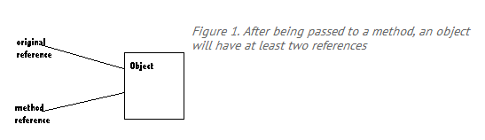

Slide 13
This is the default way Java does when passing the handle to a called method, create alias.
When you pass argument just to manipulate its value and not doing any changes to it, then you are safe.
Note: Clone() will be studied later

Slide 14
Beware…..

Slide 15
public void tricky (Point pa, Point pb)
{
Point ptemp = new Point ();
ptemp = pb;
pb= pa;
pa= ptemp;
System.out.println("X: " + pa.x + " Y: " +pb.x); System.out.println("X: " + + pa.x + " Y: " + pb.y); }
public static void main(String [] args)
{
Point pnt1 = new Point(1,2);
Point pnt2 = new Point(3,4);
System.out.println("X: " + pnt1.x + " Y: " +pnt1.y); System.out.println("X: " + pnt2.x + " Y: " +pnt2.y); System.out.println(" "); tricky(pnt1,pnt2);
System.out.println("X: " + pnt1.x + " Y:" + pnt1.y); System.out.println("X: " + pnt2.x + " Y: " +pnt2.y);
}

Slide 16
The method “tricky” is not performing swapping of object passed by main(), it swaps the objects in the function “tricky”

Slide 17
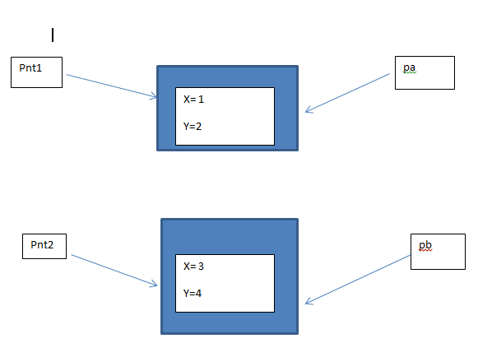
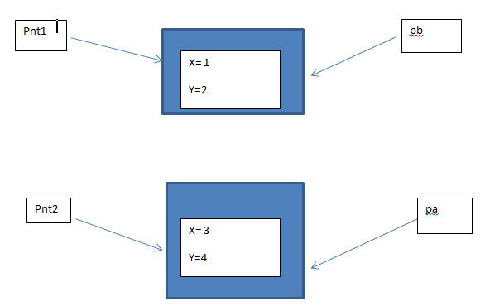

Slide 18
The equals Method
When the == operator is used with reference variables, the memory address of the objects are compared.
The contents of the objects are not compared.
All objects have an equals method.
The default operation of the equals method is to compare memory addresses of the objects (just like the == operator).

Slide 19
The equals Method
The Stock class has an equals method.
If we try the following:
Stock stock1 = new Stock("GMX", 55.3);
Stock stock2 = new Stock("GMX", 55.3);
if (stock1 == stock2) // This is a mistake.
System.out.println("The objects are the same.");
else
System.out.println("The objects are not the same.");
only the addresses of the objects are compared.

Slide 20
The equals Method
public boolean equals(Stock object2)
{
boolean status;
if(symbol.equals(Object2.symbol) && sharePrice == Object2.sharePrice)
status = true;
else
status = false;
return status;
}
Instead of using the == operator to compare two Stock objects, we should use the equals method.
Now, objects can be compared by their contents rather than by their memory addresses.

Slide 21
Methods That Copy Objects
There are two ways to copy an object.
You cannot use the assignment operator to copy reference types
Reference only copy
This is simply copying the address of an object into another reference variable.
Deep copy (correct)
This involves creating a new instance of the class and copying the values from one object into the new object.

Slide 22
Copy Constructors
A copy constructor accepts an existing object of the same class and clones it
public Stock(Stock object 2)
{
this.symbol = object2.symbol;
this.sharePrice = object2.sharePrice;
}
// Create a Stock object
Stock company1 = new Stock("XYZ", 9.62);
//Create company2, a copy of company1
Stock company2 = new Stock(company1);

Slide 23
END

